Slide 1
Solar Energy

Slide 2
Expectations Review
Class Rules:
Be Prompt
Be Prepared
Be Productive
Be Positive

Slide 3
Reminders
There will almost always be “phone time”
Assigned seats
Hall passes

Slide 4
Get to Know You (Again)
Favorite book of all time
Your favorite toy when you were 5 years old
What are you doing after you graduate high school?
Name 3 things that make you happy

Slide 5
Pre-Test
What is “insolation?”
How does the atmosphere turn light into heat?
What causes the seasons in Utah?
What is ozone?

Slide 6
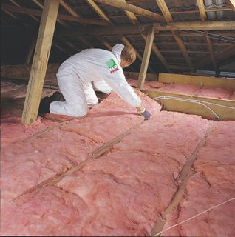
Starter 01/03/2017
What do you believe the word “insolation” means?
(FYI: Insulation is the pink stuff you put in the walls and attic of your house…it’s a completely different word!)

Slide 7
Vocabulary!
The amount of incoming solar radiation on the Earth
Insolation
Earth receives about 342 W/m²

Slide 8
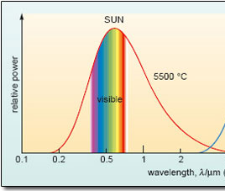
What is Solar Energy?
Sunlight travels to earth as electromagnetic radiation
UV VIS IR
The Sun emits mostly visible light, but also some UV (ultraviolet) and IR (infrared) light.
Emitted power (W/m²)
wavelength λ (μm)

Slide 9
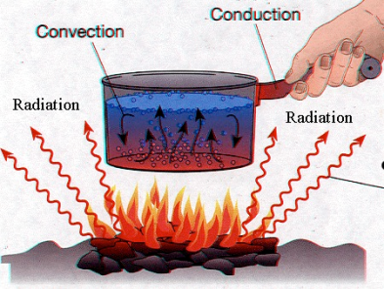
Heat
The Earth deals with three types of heat:
Radiation: waves traveling at speed of light
Convection: hot material “rises” and cold material “sinks”
Conduction: collisions between atoms or molecules

Slide 10
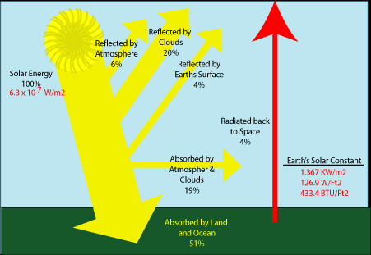
Solar Constant
We can measure solar radiation in Watts per Meter-Squared (W/m²).
Earth receives about 342 W/m² of energy

Slide 11
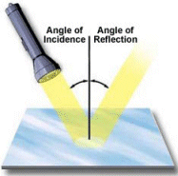
Solar energy reflected
Reflection
Change in direction of radiation. Radiation leaves in one direction.

Slide 12
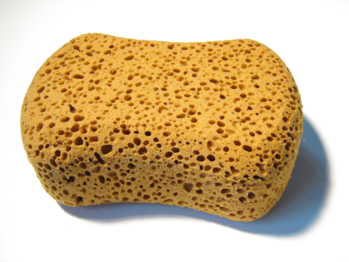
Solar energy absorbed
Absorption
Transfer of solar energy to a substance (like the ground or water).
This process changes UV light into HEAT!

Slide 13
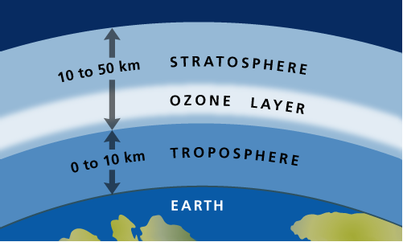
Absorption
UV radiation is almost completely absorbed by Ozone (O₃), O₂, and N₂
This protects us from harmful radiation that causes skin cancer.

Slide 14
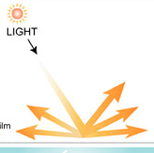
Solar energy scattered
Scattering
Change in direction of radiation. Radiation leaves in many directions.

Slide 15
Role of atmosphere
Objects in the atmosphere (like clouds) cause reflecting of solar energy back into space.

Slide 16
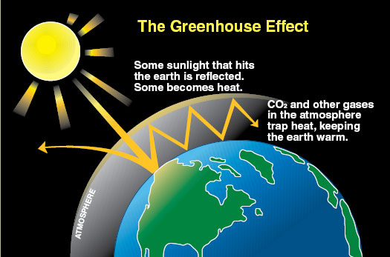
Role of atmosphere
Particles in the atmosphere (like CO₂ and H₂O) absorb solar energy and hold it as heat. We call these “greenhouse gases.”

Slide 17
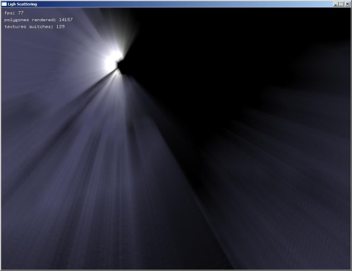
Role of atmosphere
Particles in the atmosphere (like N₂, O₃,and O₂ molecules) cause scattering of solar energy.

Slide 18
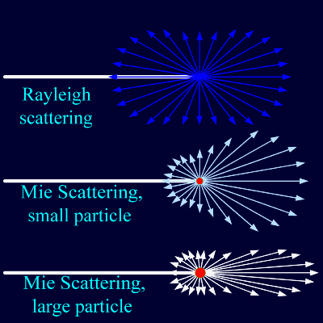
Solar Scattering
The scattering of solar radiation in the atmosphere makes the sky look blue and the clouds look white.
Equal scattering makes the sky look blue in color!
Unequal scattering makes clouds look white in color!

Slide 19
Role of oceans
Depending on the angle of the sun, oceans can reflect solar energy or absorb solar energy and hold it as heat.

Slide 20
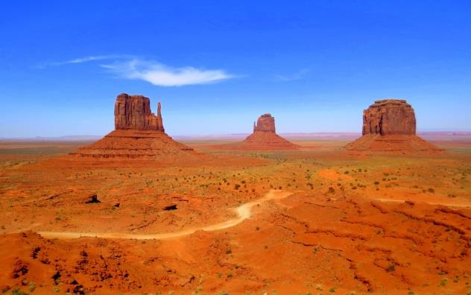
Role of dry land
Dry land absorbs solar energy and traps it in the form of heat. A small amount is reflected

Slide 21
Role of ice and glaciers
Ice and glaciers reflect solar energy

Slide 22
Global energy balance: energy flow
Source: Kiehl and Trenberth, 1997

Slide 23
Global energy balance: energy flow
Source: Kiehl and Trenberth, 1997

Slide 25
Predict: What would happen if the amount of dry land on earth DECREASED?

Slide 26
Predict: What would happen if the amount of ice on earth INCREASED?

Slide 27
Predict: What would happen if the number of clouds in the atmosphere was DOUBLED?

Slide 28
Solar Energy Math

