Slide 1
Coriolis Effect
a.k.a.—Where does wind come from?

Slide 2
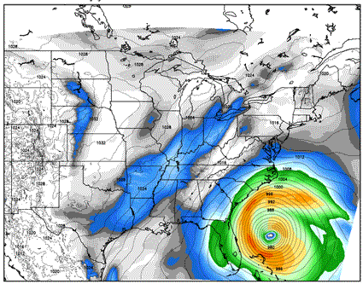
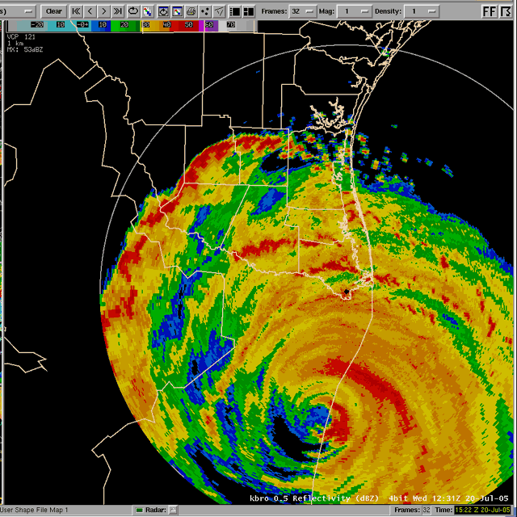
Starter 01/16/2018
Take a minute to observe these .gifs of Atlantic Ocean hurricanes.
What observations can you make?

Slide 3
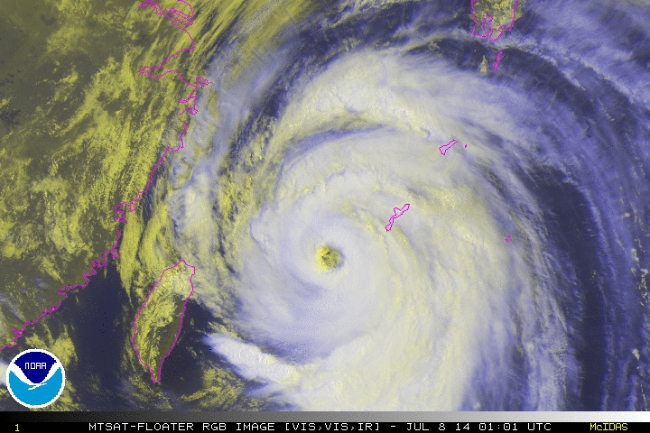
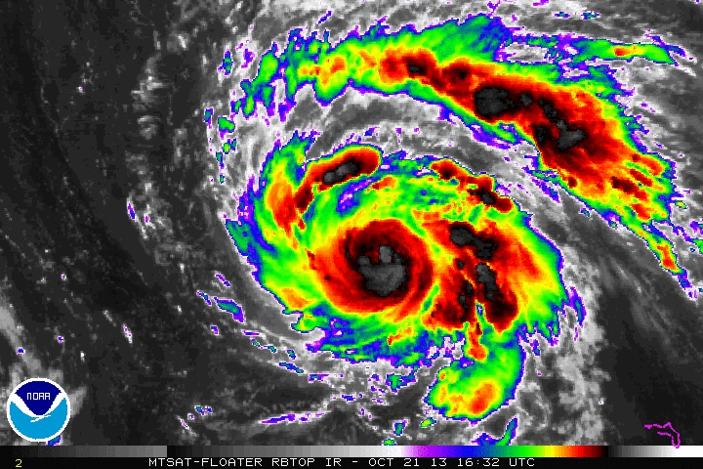
What do you noticed about these Pacific Typhoons?

Slide 4
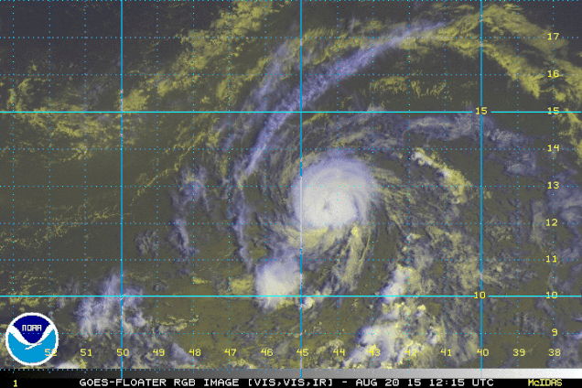
Why?

Slide 5
Make a Statement
Hurricanes move ____________ because _______________

Slide 6
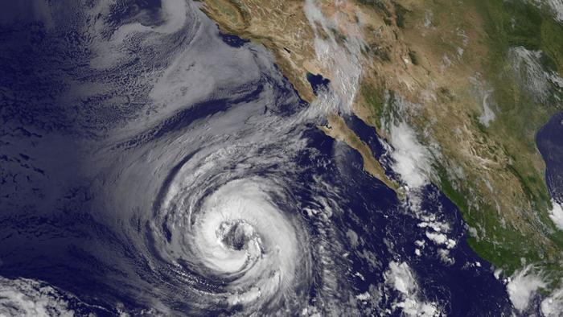
Is your statement still true?

Slide 7
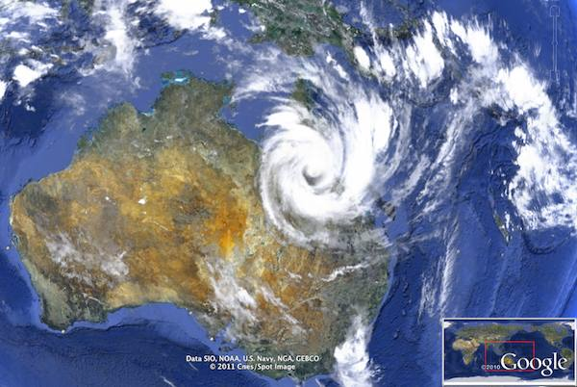
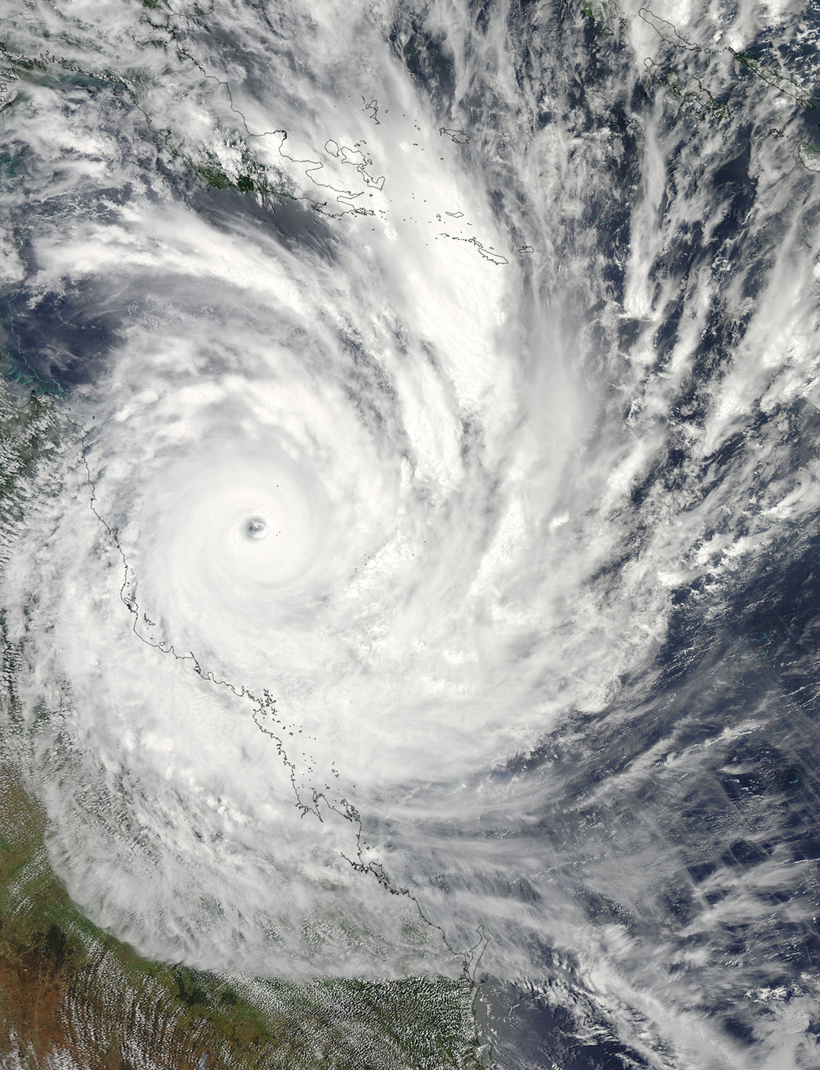
Is your statement still true?

Slide 8
Why do hurricanes, typhoons, and cyclones move in a circular pattern?

Slide 9
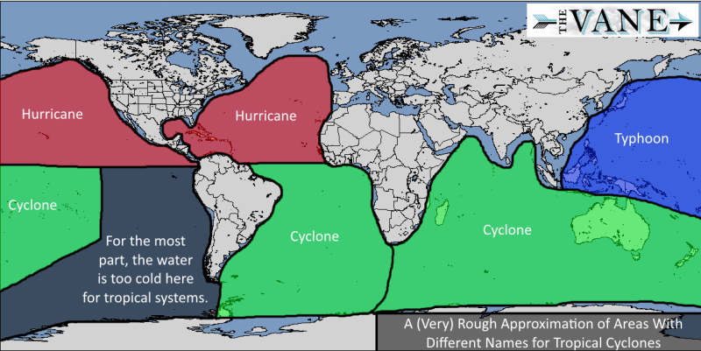

Slide 10
Starter 01/16/2018
The Earth receives an average 342 W/m² of energy each day. Do you think that Utah is receiving less than, more than, or equal to that amount of radiation TODAY?

Slide 11
Tables 1-5: Lazy Susan
Tables 6-9: Balloon Lab (page 17

Slide 12
Rules:
Spin the Lazy Susan counter-clockwise
Roll the marble slowly, in a straight line across the Lazy Susan
Do not add “spin” to your marble
1
2
4
3

Slide 13
1 to 5
4 to 2
3 to 1
2 to 4
5 to 3
1 to 2
4 to 5
1
5
2
4
3

Slide 14
Vocabulary!
A curved motion of wind and water on the planet, caused by Earth’s rotation on its axis
Coriolis Effect
Causes the Trade Winds, Westerlies, and Polar Easterlies

Slide 15
Remember, the heating of the Earth is UNEVEN!

Slide 16
This shows the amount of net incoming solar radiation the earth receives during the month of December. What observations can you make?
Notes:
Image Credit: Dr. Strong, University of Utah, Atmospheric Science Department

Slide 17
This shows the amount of net incoming solar radiation the earth receives during the month of June. What observations can you make?
Notes:
Image Credit: Dr. Strong, University of Utah, Atmospheric Science Department

Slide 18
Coriolis Effect
Uneven heating keeps the poles COLD…the water stays cold, the air stays cold, the ground stays cold.
It also keeps the equator WARM…the water stays warm, the air stays warm, the ground stays warm.

Slide 19
Coriolis Effect
Warm air rises, cold air sinks
As warm air rises, cold air takes its place.
This creates convection currents in the air.

Slide 20
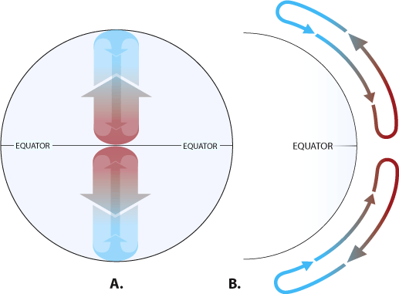
If the Earth did not rotate on its axis and remained stationary, the atmosphere would only circulate between the Earth's polar regions (cold, sinking air) and the equator (warm, rising air) in a simple back-and-forth pattern.
Notes:
Image: NOAA (http://oceanservice.noaa.gov/education/kits/currents/05currents1.html)

Slide 21
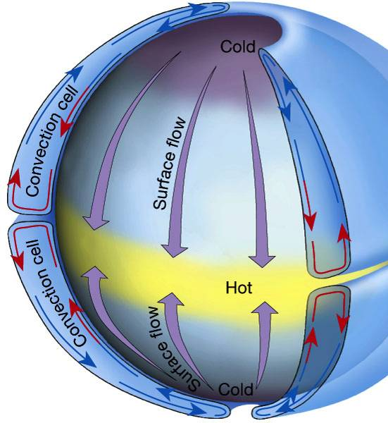
Coriolis Effect
The sun heats the equatorial regions more than the poles.
Simple, single atmospheric convection current in each hemisphere.
Lutgens and Tarbuck (2001)

Slide 22
Coriolis Effect
As the Earth spins, it moves the gases in the atmosphere with it.
This creates a curved path that the winds follow.

Slide 23
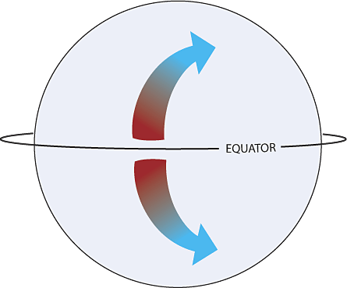
The rotation of the Earth on its axis moves air in the atmosphere toward the right in the Northern Hemisphere and toward the left in the Southern Hemisphere, resulting in curved paths.
This is called the Coriolis Effect.
Notes:
Image: NOAA (http://oceanservice.noaa.gov/education/kits/currents/05currents1.html)

Slide 24
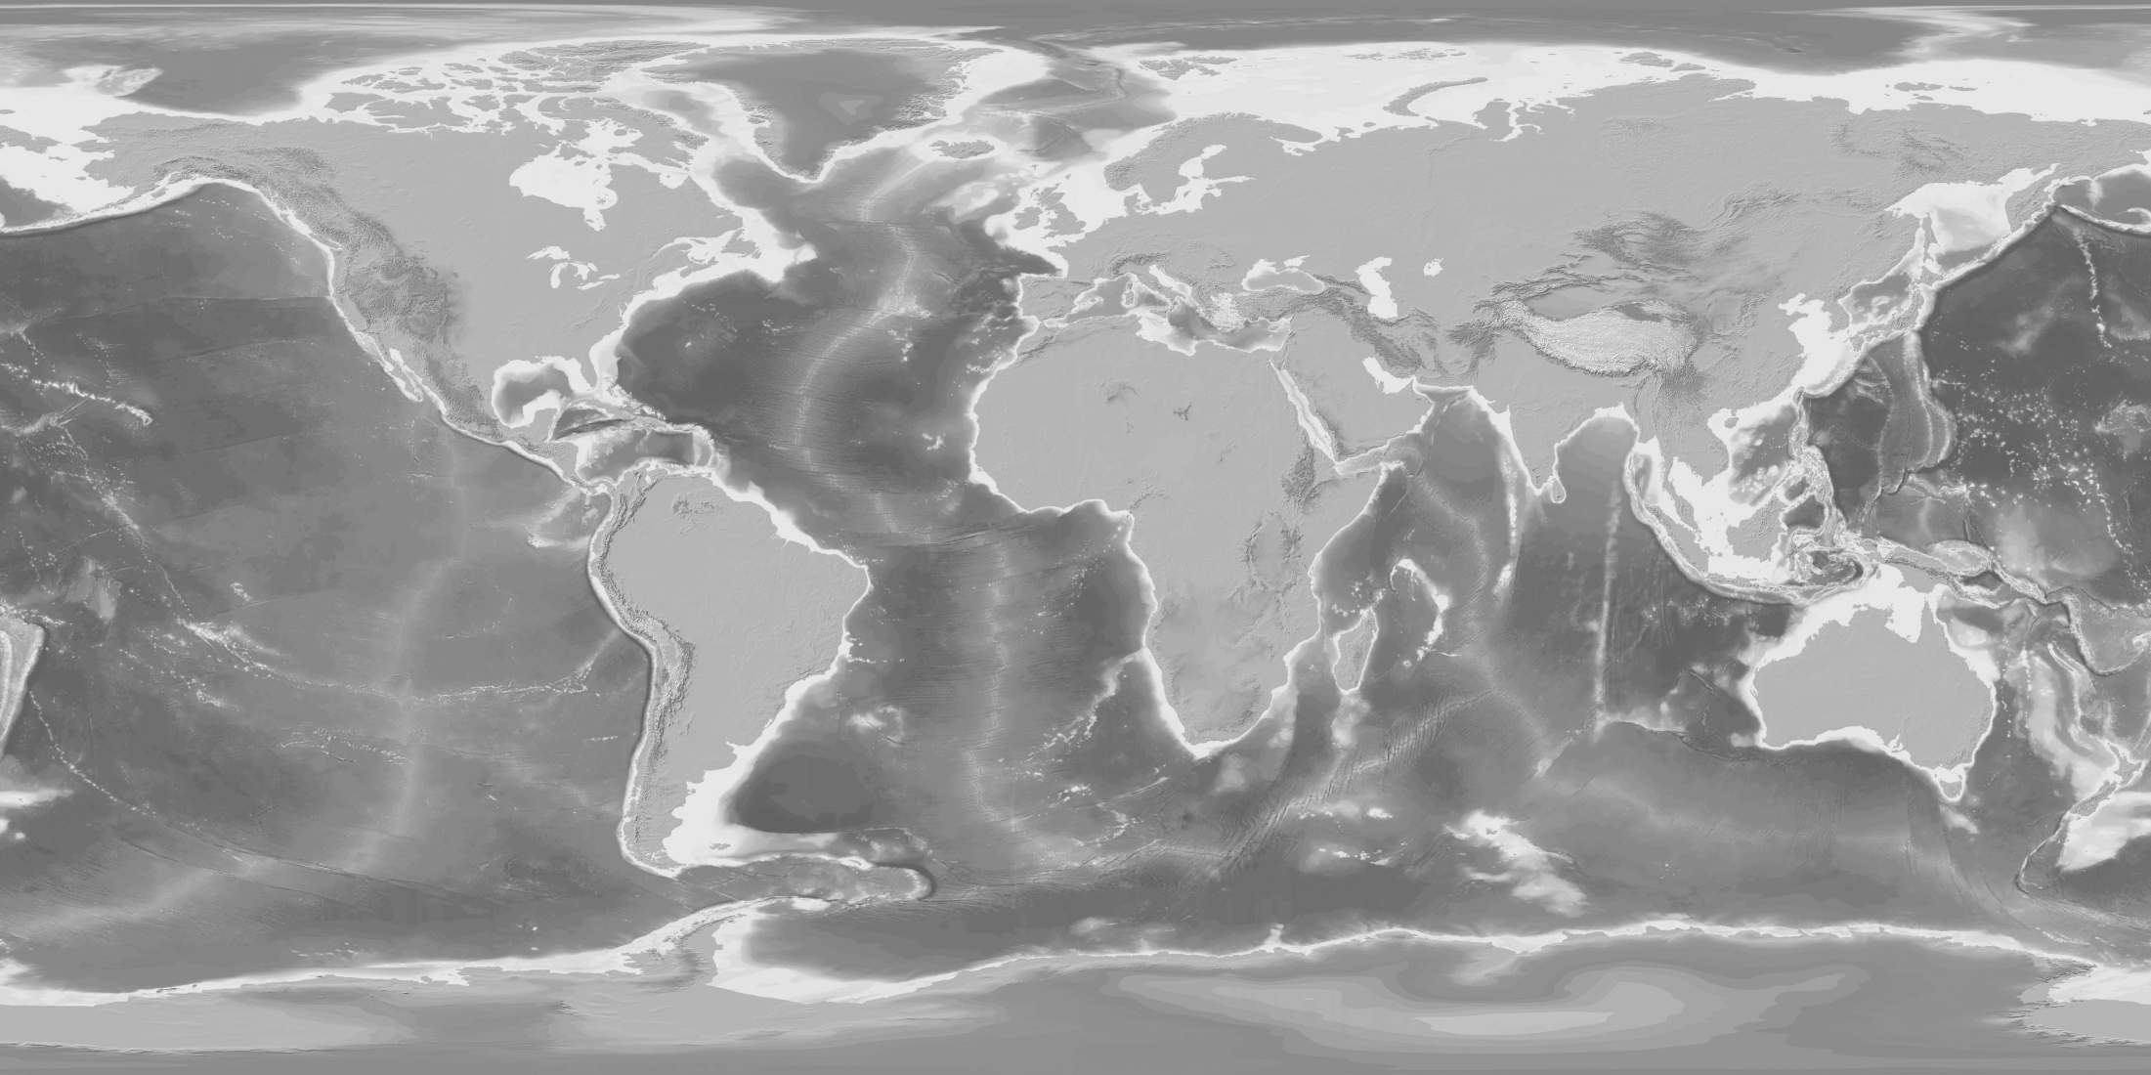
90° N
60° N
30° N
0°
30° S
60° S
90° S
Warm air at the equator rises. Cooler air from the North rushes to take the place of the rising air. But the spinning of the earth causes the moving air to bend to the right.

Slide 25
90° N
60° N
30° N
0°
30° S
60° S
90° S
Cooler air from the South also rushes to take the place of the rising air. But the spinning of the earth causes the moving air to bend to the left.

Slide 26
90° N
60° N
30° N
0°
30° S
60° S
90° S
We call these the TRADE WINDS. They were used by sailors to travel to other continents to sell and trade goods.

Slide 27
90° N
60° N
30° N
0°
30° S
60° S
90° S
Farther North, the air is sinking, but still bent to the right!

Slide 28
90° N
60° N
30° N
0°
30° S
60° S
90° S
Farther South, the air is sinking, but bends to the left!
These Orange Arrows are PREVAILING WESTERLIES because these winds come from the west.

Slide 29
90° N
60° N
30° N
0°
30° S
60° S
90° S
At the North Pole cold air wants to move toward the equator, but it is bent to the right.

Slide 30
90° N
60° N
30° N
0°
30° S
60° S
90° S
At the South Pole cold air also wants to move toward the equator, but it is bent to the left. These blue arrows are called POLAR EASTERLIES.

Slide 31
Coriolis Effect
Temperature differences AND pressure differences create “cells” of air.
Warm air rises at the equator and begins to cool.

Slide 32
Coriolis Effect
As the air cools it begins to sink back toward the surface.
This happens in the Northern and the Southern Hemisphere.
We call these pockets of air “Hadley Cells”

Slide 33
Coriolis Effect
Pressure creates a similar set of currents between 30°
and 60°
We call these pockets of air “Ferrel Cells”
Ferrel Cells are smaller and more weak than Hadley Cells

Slide 34
Coriolis Effect
The air at 60° is warmer than the air at 90°, so this creates a third, very small air current.
These are “Polar Cells”
Polar cells are very weak.

Slide 35
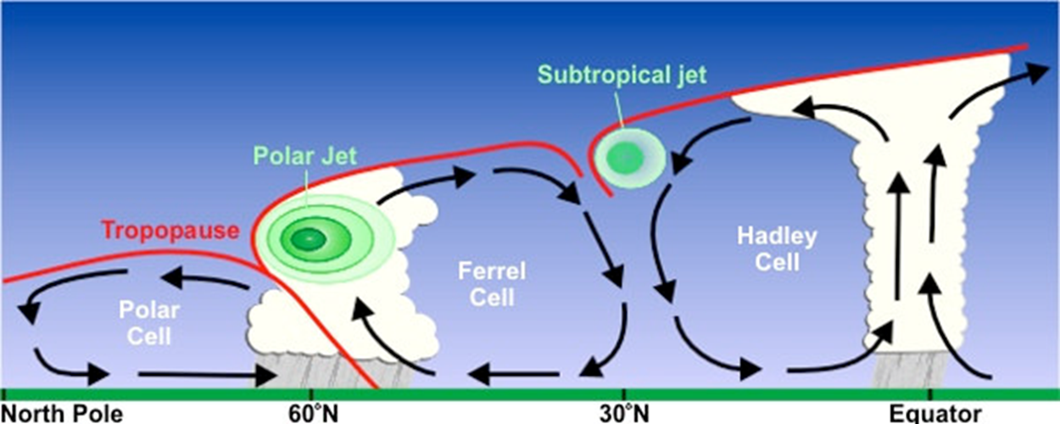
Here are the air cells as if we could view them from the surface of the earth.

Slide 36
Putting it all together…

Slide 37
Exit Card
Why would an airline pilot need to know about the Coriolis Effect?

